Slide 1
AI for Kids
UK Robotics Week 2024

Slide 2
This Story is about my story is about primary school children who are resisting education don't want to study programming yet and they're 8 years old and they need to be disciplined
This story is created by:
Zeinah
Hana
Manal

Slide 3
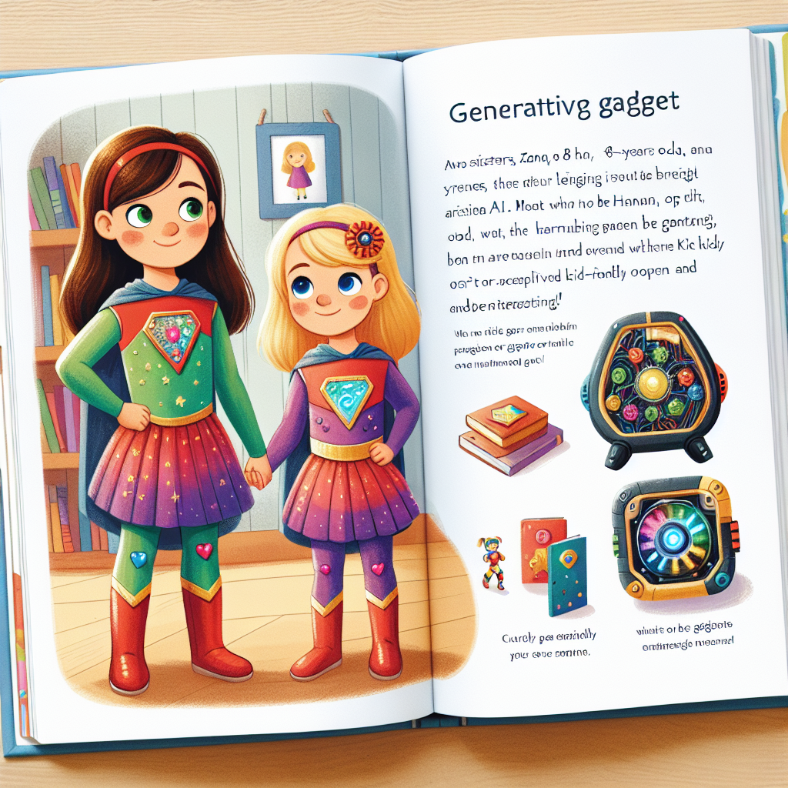
Zana and Hannah can start using generative AI in small steps like helping with homework or learning new things. Encourage them to ask questions and explore how
AI can assist them. It's important to monitor their usage and guide them on using AI ethically and effectively. Gradually introduce more complex tasks to expand their skills.
Create an illustrated page from a children's story book. Show two sisters, Zana, an 8-years old, and Hannah, a 5-year-old, standing together in colourful superhero attire, their unique emblems proudly displayed. They are curious with bright eyes, open to learning and adventures. On the page include a cleverly designed gadget that represents generative AI, which should be kid-friendly and interesting. The setting is their bedroom which is filled with books and toys, symbolizing a nurturing and educational environment.

Slide 4
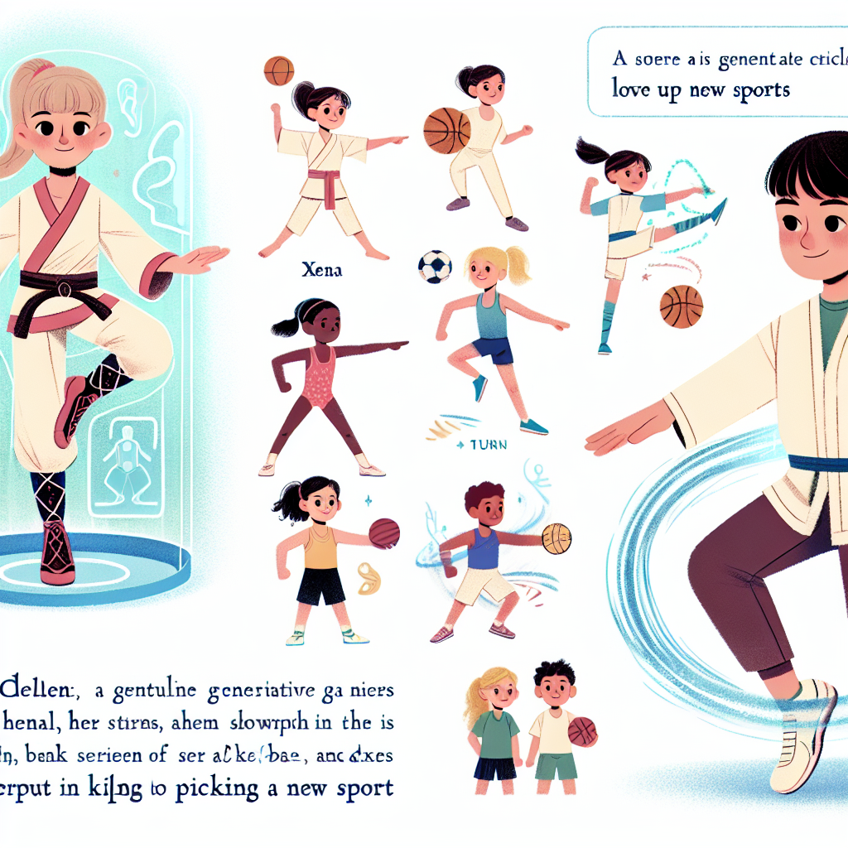
In the early morning, the superhero uses generative AI to plan a healthy breakfast, go to school, engage with teachers and colleagues, and study. The superhero also advises their family on leisure activities. The superhero is interested in studying history and using generative AI to learn efficiently. As the
superhero advances in education, they explore ancient civilizations and comparative history studies. Finally, the superhero transitions to university, focusing on geography studies with the help of generative AI. From primary school to a PhD program, generative AI proves to be a valuable tool for learning and research for the superhero.
A children's book illustration is required. The scene in focus is Xena, a young girl exhibiting her graceful karate moves. This needs to be detailed, showcasing jumps, turns, and strikes. Another character needed is Hannah, a girl of the same age, eager to explore new sports. Display a series of different sports around her; like swimming, basketball, and dance, to suggest her interest in picking up a new sport. Both girls are getting assistance from a gentle generative AI helper, shown as a friendly holographic figure offering advice. The output needs to spark curiosity and love for sports.

Slide 5
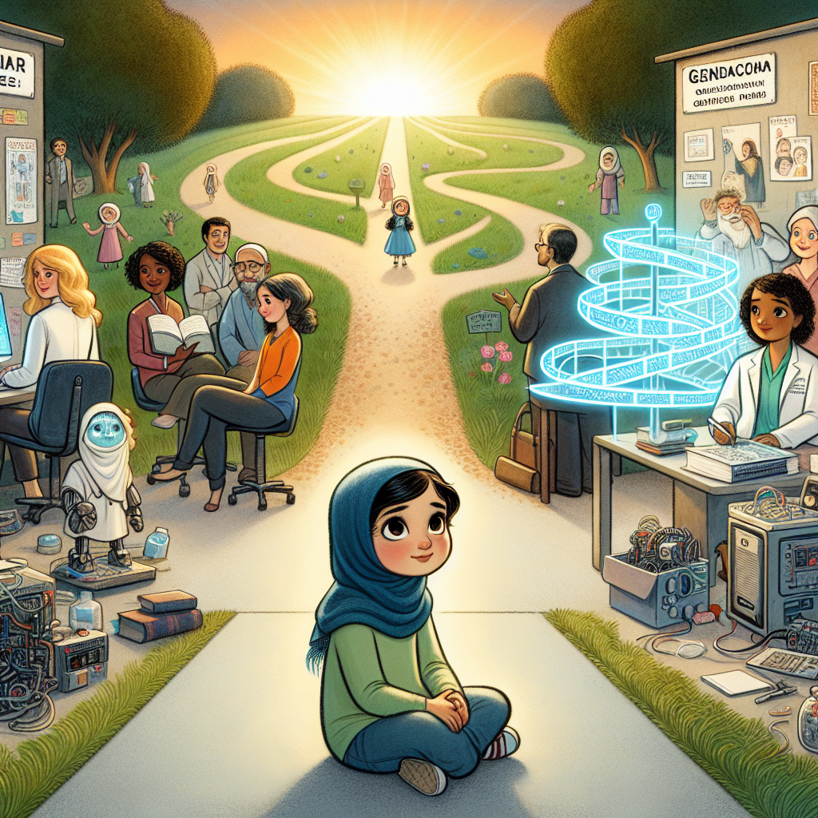
Incorporate generative AI into Zana and Hannah's learning activities gradually to enhance their skills. Encourage them to explore various sports with
AI assistance tailored to their age-appropriate needs. The family's diverse backgrounds can provide unique perspectives in the field of generative AI.
A children's storybook scene where Zana, a young Middle-Eastern girl with curiosity in her eyes, sits at a crossroads. To her left, the path represents her family career path, bustling with various engineers busily working at their computers, creating intricate designs and solving complex problems. To her right, the path illustrates her grandmother's gynaecology practice, showcasing a comforting medical office. Up ahead, a third path shines brightly, symbolizing the emerging field of Generative AI. Distant figures on this path wave at Zana from amongst holographic screens and adaptive machines, beckoning her to consider a future not bound by her family's traditional professions.

